Slide 1

Rockbuster Stealth Annual Review 2022
Ian McQuillen

Slide 2
Agenda
Introduction
Analysis
Conclusions

Slide 3
Introduction
Looking at the past year’s data, we will investigate key areas such as:
Where are Rockbuster’s customers?
Which of those places are earning us the most profit?
Who are our most valuable customers?

Slide 4
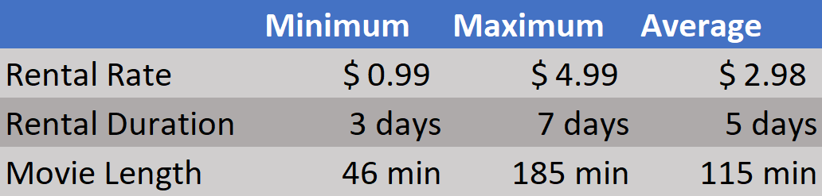
Basic Movie Information

Slide 5
Analysis
Looking at the past year’s data, we will investigate key areas such as:
Where are Rockbuster’s customers?
Which of those places are earning us the most profit?
Who are our most valuable customers?

Slide 6
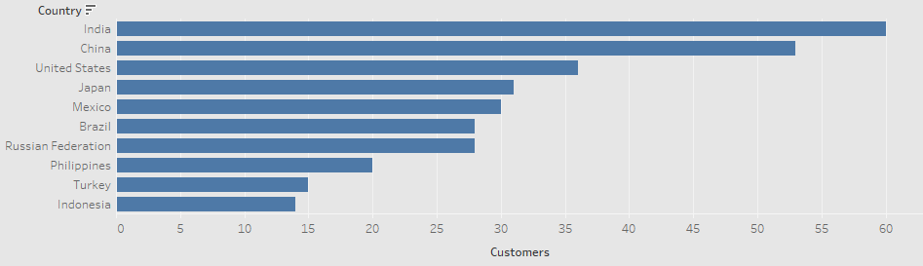
Top 10 Countries by Number of Customers

Slide 7
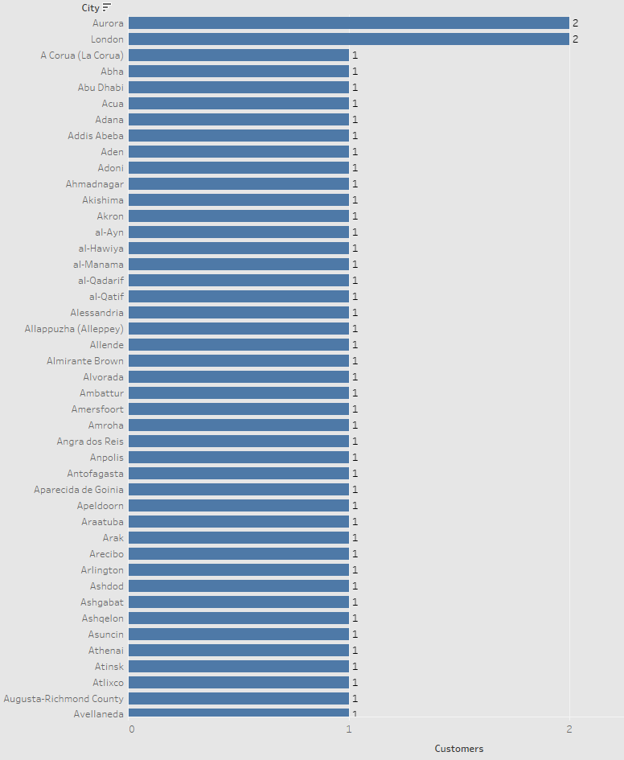
Number of Customers per City
When we drill down to the city level, nearly every city has just a single active customer
This makes any attempt to rank cities by the number of customers futile

Slide 8
Analysis
Looking at the past year’s data, we will investigate key areas such as:
Where are Rockbuster’s customers?
Which of those places are earning us the most profit?
Who are our most valuable customers?

Slide 9
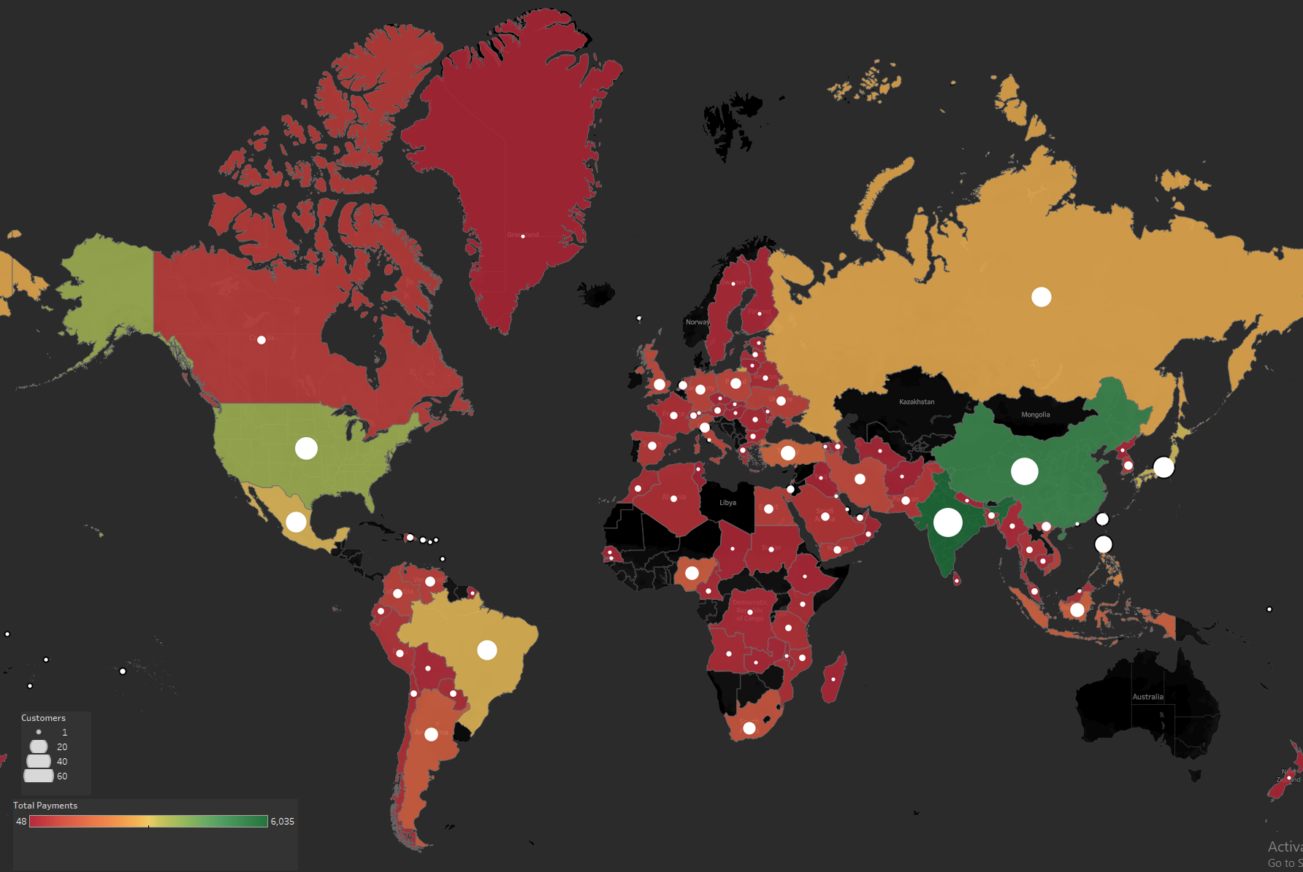
Global Distribution of Customers & Payments

Slide 10
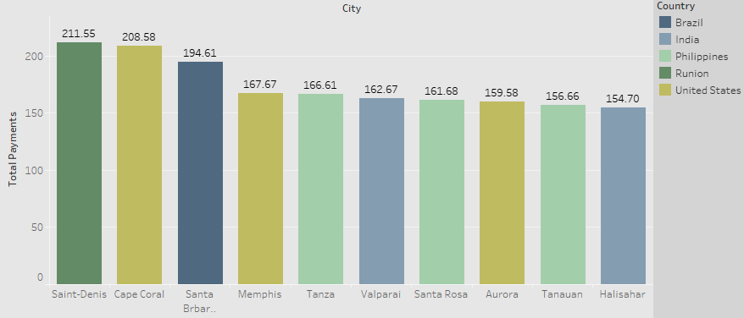
Ranked Earnings from Cities in Top 10 Countries

Slide 11
Geographic Patterns
Our top 3 earning countries are
India
China
USA
This is identical to our top 3 countries by total customers
Among the top 10 countries, only 5 have cities in the top 10 by earnings

Slide 12
Analysis
Looking at the past year’s data, we will investigate key areas such as:
Where are Rockbuster’s customers?
Which of those places are earning us the most profit?
Who are our most valuable customers?

Slide 13
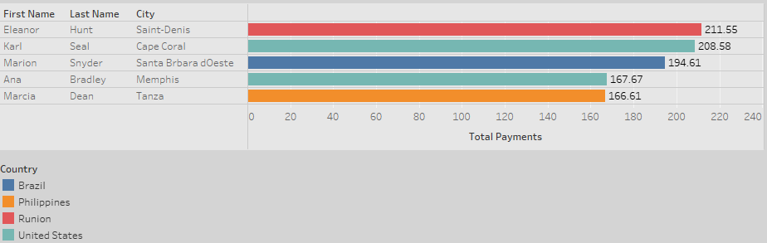
Rockbuster’s MVP Customers by Spend

Slide 14
Customer Trends
A worrying global trend: it appears that each city may use 1 person’s account for the entire citywide population
The small island of Reunion is home to our highest spending customer, Eleanor Hunt!
The USA has the highest volume of big spenders

Slide 15
Conclusions
More customers = more earnings for us
Our biggest spending customers are not consistently located in our highest earning countries
We are performing the best in Asian markets
We have little market penetration in Africa and Europe
We must investigate the 1 customer per city phenomenon

Slide 16
Questions?
Click here to see this presentation hosted on Tableau Public
ian.mcquillen@Rockbuster.biz

